Slide 1
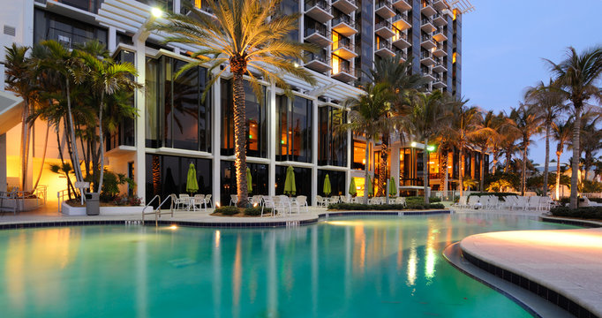
HOTEL DATA ANALYTICS

Slide 2

Presented By
NAME:- Shivangi Patel
BATCH:- Data Analytics
Guide By
MANTOR NAME:- Abhishek Sir

Slide 3
Summery:
1. The given dataset is of Hotel Booking and we have to analyse and explore this dataset to discover important factors which affects the Hotel Booking. This dataset has 119390 rows and 32 coulumns.
2. The duplicate value count is 31994 rows.
3. There are 4 columns in dataset which is having missing valuse and those columns are company, agent, country and children.
4. There are separate columns called adults, children and babies that show the total number of people who are coming to visit, so instead of different columns will add these three in one called total_num_people

Slide 4
Problem Statement :
This data set contains booking information for a city hotel and a resort hotel, and includes information such as when the booking was made, the number of adults, children,and/or babies, and the number of available parking spaces, which agent made the booking , among other things.
The objective of this project is Explore and analyze the data to Discover important factors that govern the bookings.

Slide 5
Variable description:
hotel - Type of hotel(Resort or City).
is_canceld - If there was booking cancel(0) or not(1).
lead time - The number of days between time books their room to arrive hotel.
arrival_date_year - Year of arrival date.
arrival_date_month - Month of arrival date.
arrival_date_week_number - Week no. of year for arrival date.
stays_in_weekend_nights - No. of weekend nights(Saturday or sunday) spend by guest at hotel.

Slide 6
stays_in_week_nights -No. of weeknight( Mon to Fri) spend by guest at hotel.
adults - No. of adults among guest.
children - No. of children among guest.
babies - No. of babies among guest.
meal - Type of meal booked by guest.
country - Country of guest.
market_segment - grouping into categories based on their booking patterns and t…

Slide 7
Define Business Objective??
Analyse and visualize the data on bookings of City Hotel and Resort Hotel to gain insights on the different factors that affect the booking and ADR.
ADR: Average Daily Rate

Slide 8
TABLE OF CONTENTS
01
02
03
Extract
Transform
Cleaning
04
05
06
Load
Chart
Result
We can load and Extract the data
We can transform it
We can clean the data in power bi
We can Load and apply after transform ig.
After load and apply we can create multiple charts
After cleaning and analysing we can easily find the result

Slide 9
1.Data Extract:
-First I checked that the data is in which form like, Excel,Csv,Sql…
-Then i find the data is in Csv file.
-Data from csv file taken in Power BI.
2.Transform:
-Transform the collected data in to the Power Bi.

Slide 10
3.Cleaning:
-After transform the data in Power Bi , i have done first process is change the data types where i need.
-Second step which i follow is merged the date column using custom column and convert it to the date format.
-Then remove null values and error in the hotel data.
- Set A primary key as a guest Id in the Hotel data.
4.Load:
-After completing all the processes of the cleaning, I loaded the data using close and Apply.

Slide 11
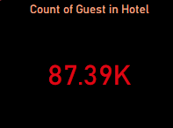
1.Count of Guest in Hotel
I used Card Chart because This chart is easily describe to the total number of people booking in hotel..
The result was there are 87.39k Guest Booking Both Hotels in Year of 2015,2016 and 2017.

Slide 12
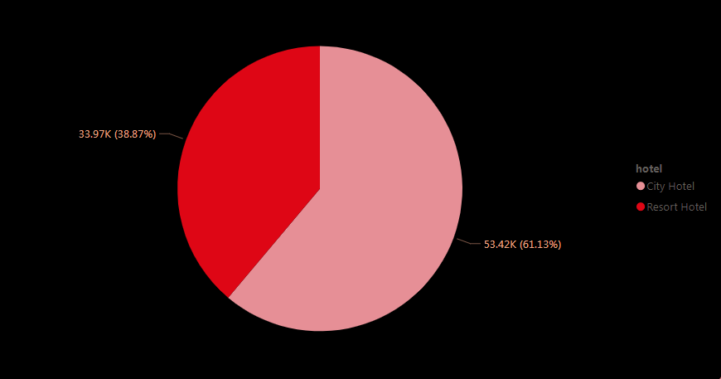
2.Count of Guest in City Hotel and Resort Hotel
This chart i use in count of guest to city hotel and resort hotel.
In this chart ,People prefer to stay in city hotels more compare to result hotels.
61.13% of people are like to stay in city hotel it means resort hotel has a develop and Provided Many types to facility to attract to the people.

Slide 13
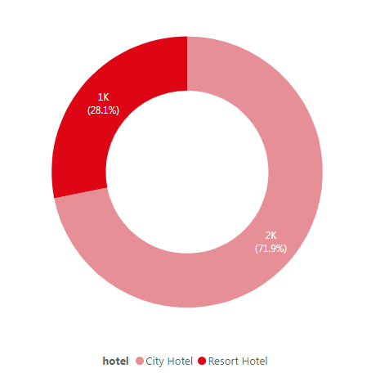
3. Hotel wise Cancellation
I use Donut Chart because I find the Categorical data, City Hotel and Resort Hotel.
Hear i mention to city hotel cancellation and resort hotel cancellation.
Hear the City hotel more cancelation compare the Resort Hotel.

Slide 14
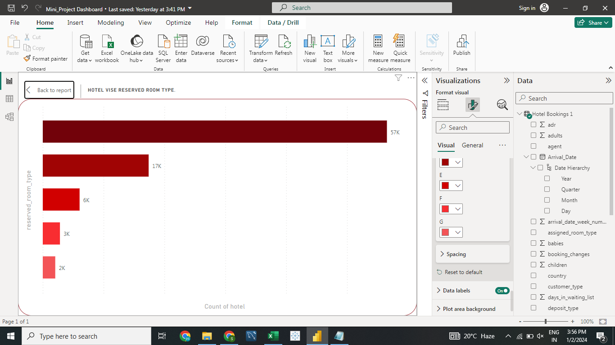
4. Hotel wise Reserved Room type
I used the Clustered Chart To check and understand the people is preferred which platform is use for more booking .
Here i find hotel wise room type.
Which room type book maximum time and wich minimum .
I find the room type A is maximum booking almost 57k people are booked.

Slide 15
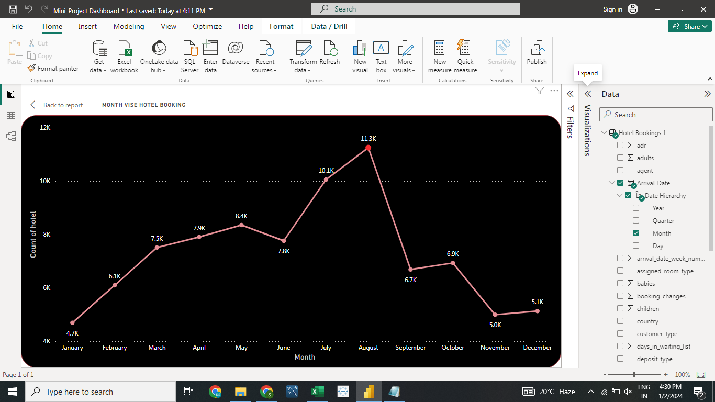
5.Month wise Hotel Booking
I used the Line Chart To check and understand the How many people is preferred Monthly Booking.
In this chart i describe Month wise booking and i see maximum booking on august month. There are total 11253 booking only one August Month.

Slide 16
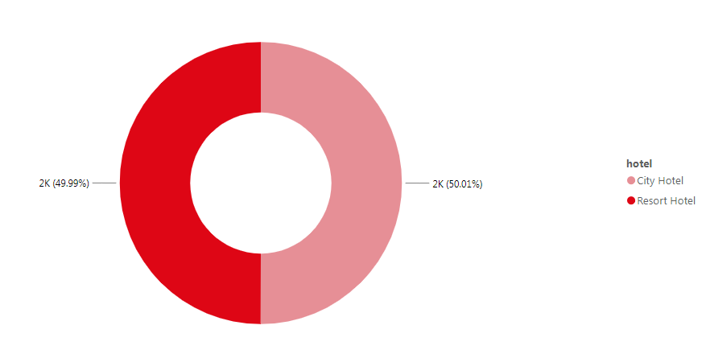
6. Hotel wise Repeated Guest
I use Donut Chart because I find the Categorical data, City Hotel and Resort Hotel.
In this chart i find Hotel wise repeated guest and i find almost same result.
I choose Donut graph because it's easily describe the result.

Slide 17
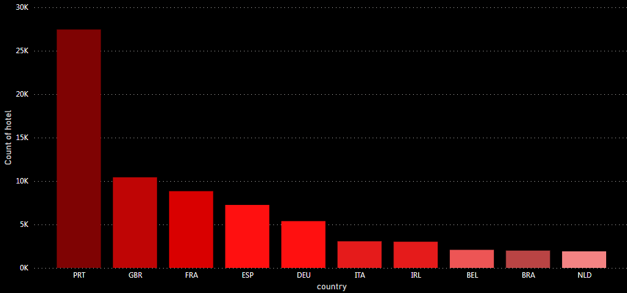
7. Top 10 Country wise Booking
Here i use column chart i find top 10 country wise Booking like which country is maximum booked the hotel.
I use this chart because here many countries i describe easily.

Slide 18
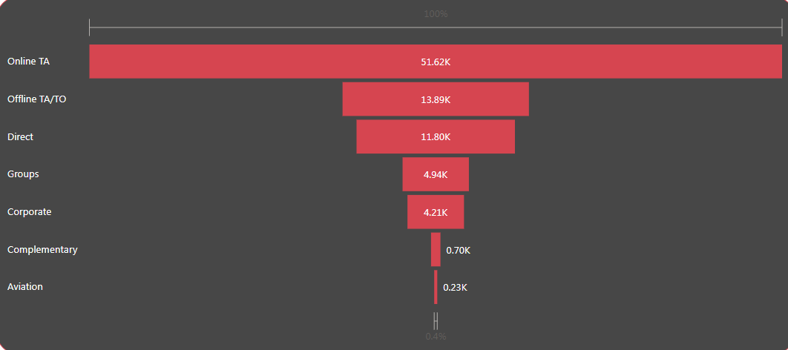
8.In which market segment did the Guest Booking?
I used the Funnel chart To check and understand the How many People are booking hotel which segment through.
Here i find market segment did the guest booking.
Based on the above observations, I found that mostly the Online TA bookings are higher compare to others.

Slide 19
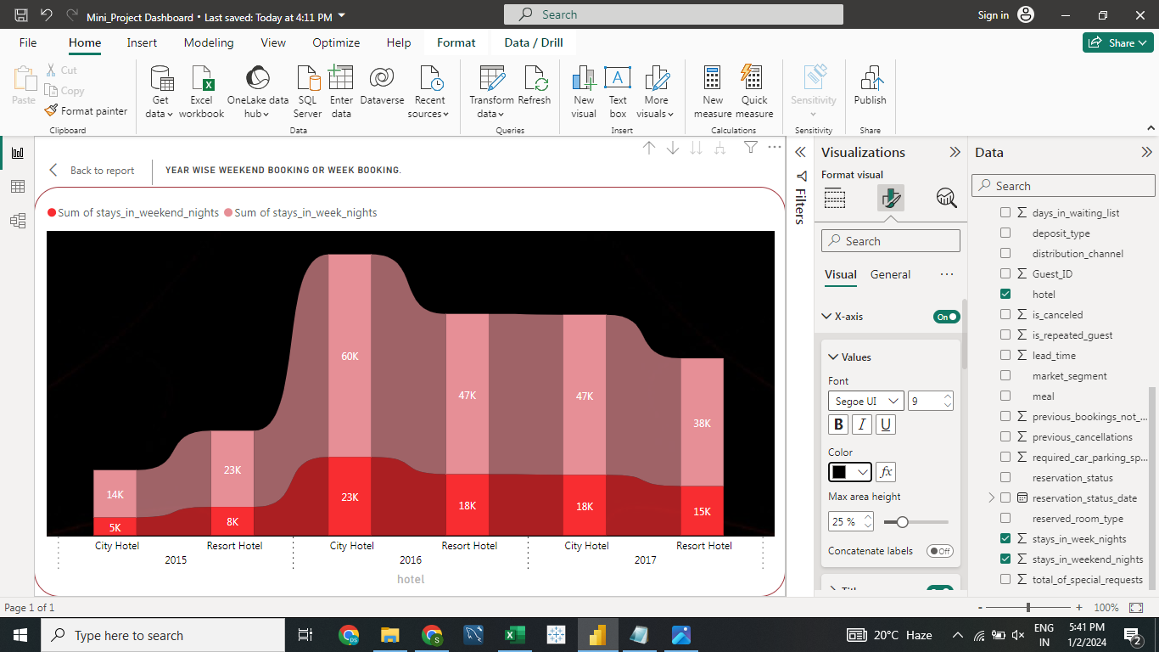
9.Year Wise Weekend Booking or Week Booking?
Hear i used Ribbon Chart because i find multiple values through this graph.
I find year wise stay week night or weekend night Booking and Which hotel most booked.
Result was Most Booked Hotel is City Hotel there is around 60000 people are booked in week nights and year is 2016.
Also Weekend night booking is higher than resort hotel there is around 23000 people are booked in year 2016.

Slide 20
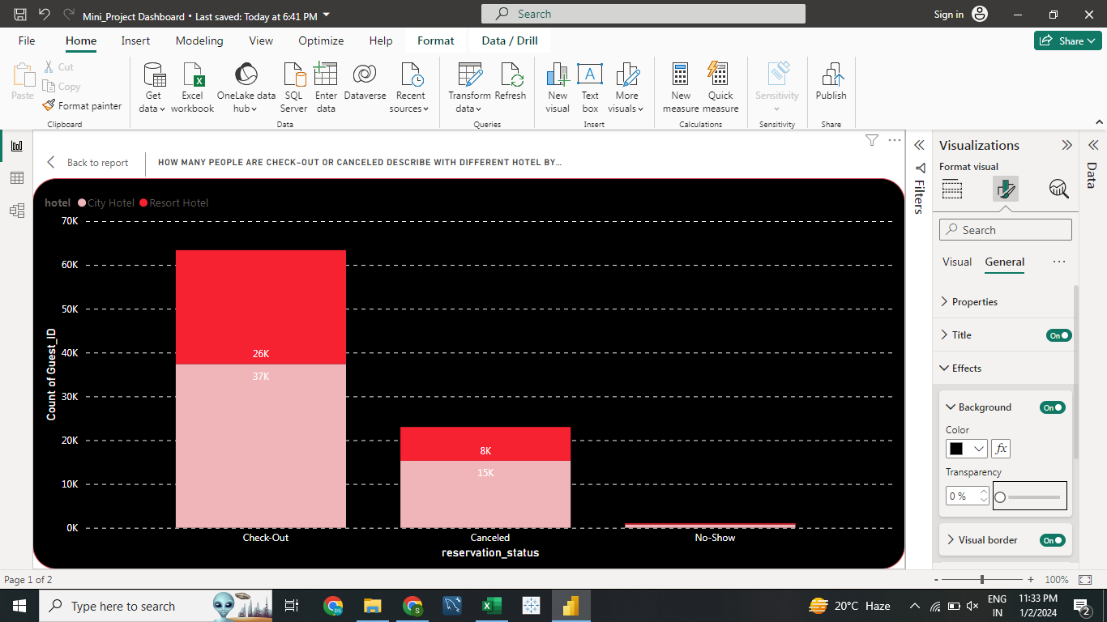
10.How Many People are Checked-Out or Cancelled Describe with Different Hotel by count of guest Id
I used Stacked Column Because i find different hotel type to checked reservation status.
The result was City Hotel are More Check Out Compare to resort hotel. And Resort Hotel is less Cancelled Compare to City Hotel.

Slide 21
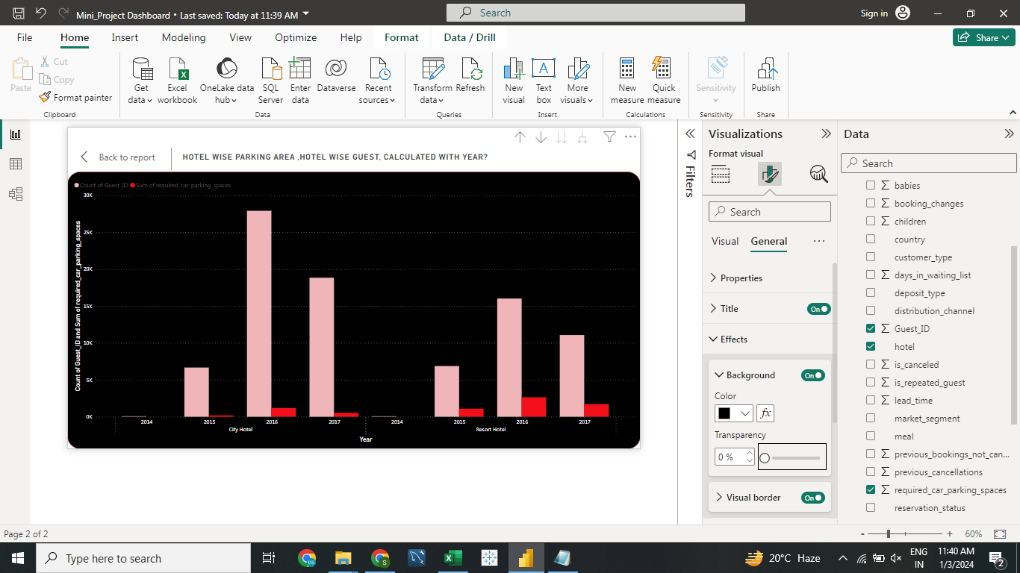
11.Hotel wise parking area and guest calculated with year.
I used Clustered Column Chart because i try to find Hotel wise Parking Segment and year wise Hotel Growth.
Result Was a City Hotel Provide More Parking Space Compare to Resort Hotels.
Hear we can see In year 2016, more bookings were made Compare to 2014 and 2017. In 2016 Growth is Higher But in 2017 Both hotels are Loss Compared to 2016.

Slide 22
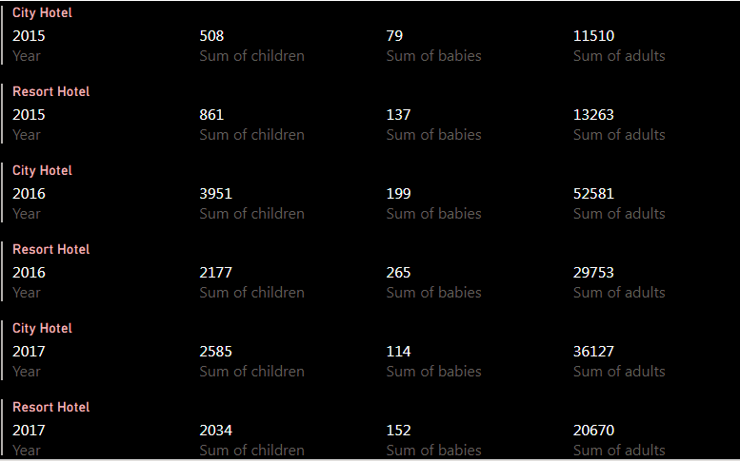
12.Count adults,children and babies by year wise booking.
I Used Multi rows Card Because i describe in One card Multi row analysis.
In this chart i describe year wise booking Cound Adults booking,Children booking and Babies Booking.
In 2014, the least bookings were for adults only, no babies booking, no children booking.
The highest booking happened in 2016, in which adults are more and babies are less.

Slide 23
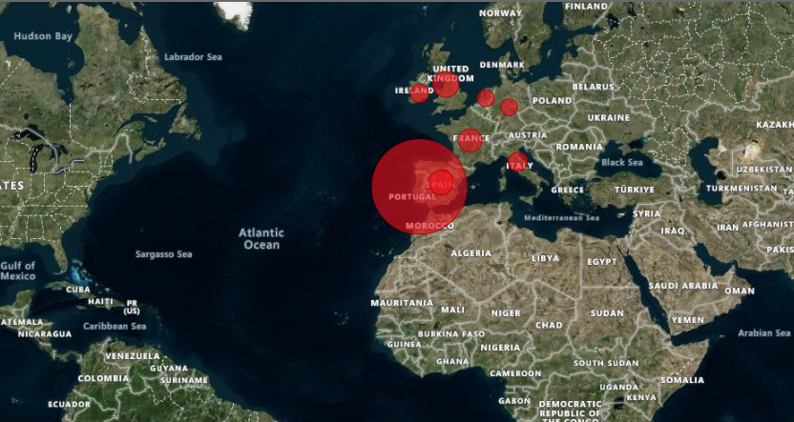
13.Top 10 Repeated guest in Country.
I used Map because i try to find top 10 location (Country) wise Repeated Guest in Both Hotel.

Slide 24
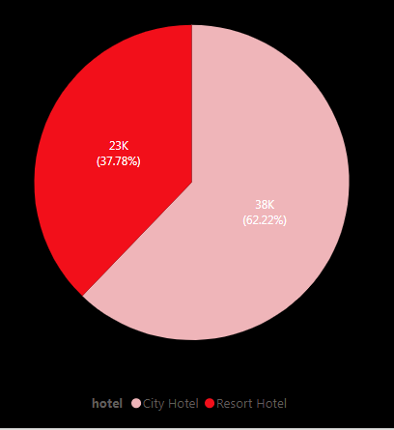
14.wich Hotel offers maximum special request?
I used the pie chart To check and understand the hotel Offer Maximum special request.its categorical data.
The result was City hotel is Maximum special request to hotel staff.
There are 62.22% special offer request in city hotel and 37.78% Special offer request in Resort hotel.

Slide 25
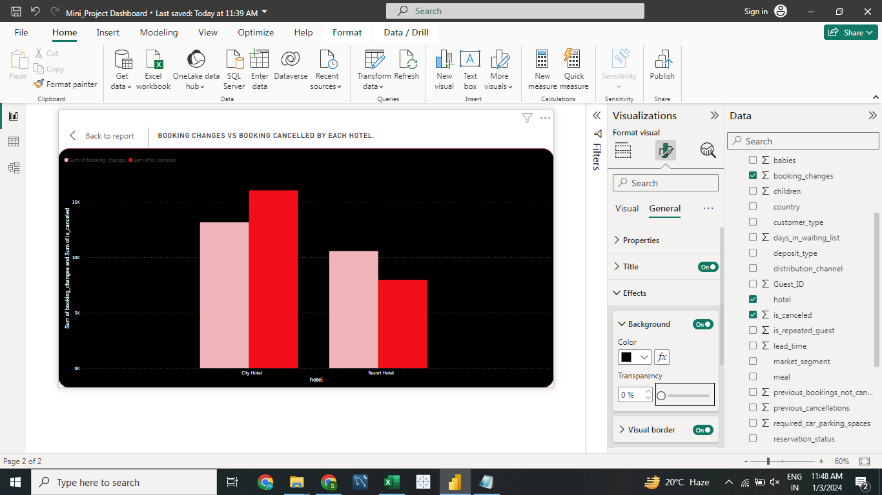
15.Booking Changes vs Booking cancelled by each hotel.
Hear I used Clustered Column chart because i try to find Booking Changes vs Booking Cancelled By each Hotel.
City hotel is more cancelled compare to Booking Changes.
Resort Hotel more changes and less cancelled.
Compare both hotel and we can see resort hotel is better than city hotel because the Resort hotel is less cancelled and More changes and City hotel is More Cancelled and less Changes booking

Slide 26
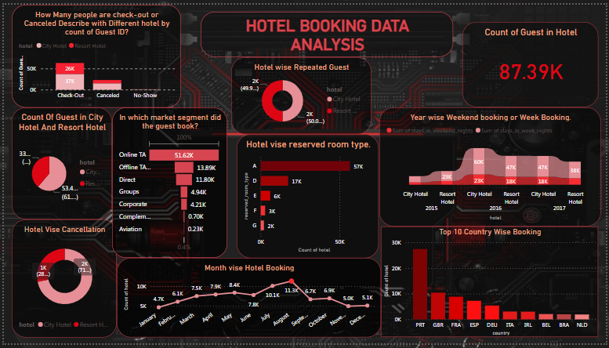
Story telling,Experiment with charts:

Slide 27
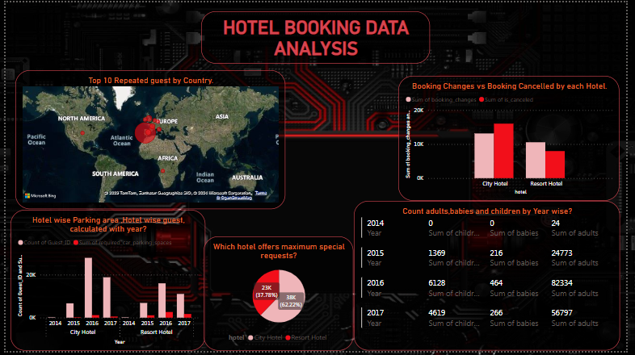
Story telling,Experiment with charts:

Slide 28
Solution to Business Objective.
Solution of The Project if Resort Hotel Increase his Business then It has Develop More Facilities And Provided many Amenities to Attract to the people .
Amenities And Facilities like Parking facilities , Multi types of Dinner and Lunch Facilities , etc...
And Last And Most Important Thigs To Know About Customers Interesting Activities .

Slide 29
Conclusion
Conclusion Of the Whole Project 61.13% People Preferred A city hotel for stay because of multiple Reason.
And 38.87% people Preferred Resort Hotel because of lake of Facility and this hotel is far away from City so in holidays seasons customers this hotel.
If Resort Hotel improve his Amenities then Chance to increase his Business.

Slide 30

THANKS!!
Do you have any Question??

